Slide 1
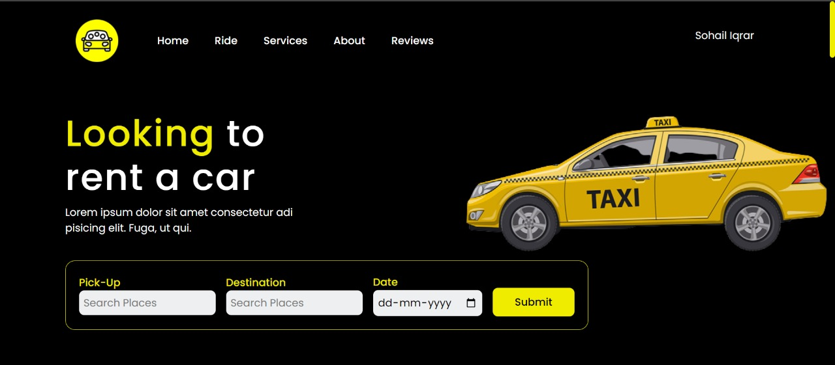
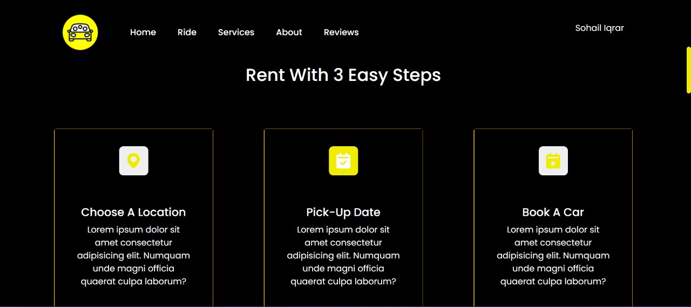
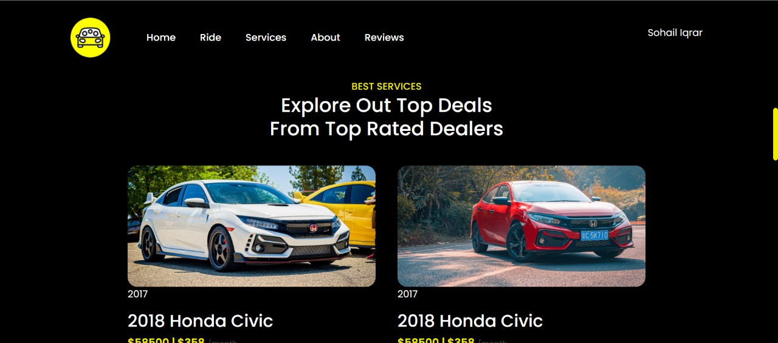
TRANSPORT OPMTIMIZATION PROGRAM (T.O.P.)
Group Members:
Harshit Gupta – 20BCS4925
Kinshuk Chauhan – 20BCS4917
Ashutosh Kumar – 20BCS4960
Ankul Agnihotri – 20BCS4913
Sohail Iqrar – 20BCS7814

Slide 2

Introduction
Due to the increasing amount of peoples, every single people travel to their Destination alone in their own car. Traveling alone leads to increases individual fuel costs. The carpooling system merges multiple new people in a car which leads to meeting new people in a car, reducing air pollution and noise pollution. The carpooling system saves the economy of every people as they share their rides and also share the cost with the other member in the car. It will stop endless Spending money on travel. Rather than using public transportation such as local trains, buses, and metros.

Slide 3

What is car pooling ?
Carpooling is a mode of transportation in which a non-profit driver can share a common route and time in their personal car with passengers. Researchers believe that the characteristics of participants in carpool trips influence carpool formation.

Slide 4

Objective
The main objective of this project is to create a platform to solve major environmental issues and to provide customers with optimized facilities. This is going to prove a good approach to resolving the issues related to costly cab booking and also save the time of the customers.
This will also have several good effects like a better use of resources and a reduction in time incompatibility.

Slide 5



What we have use in our project ?

Slide 6
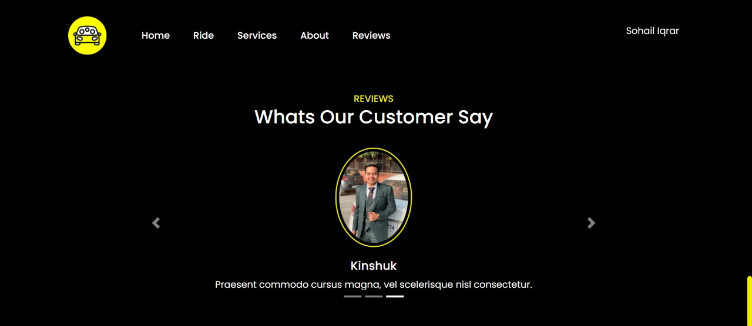
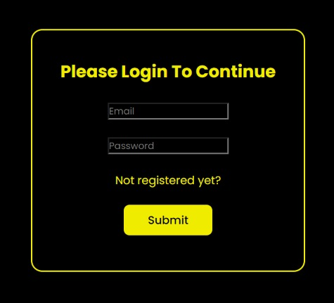
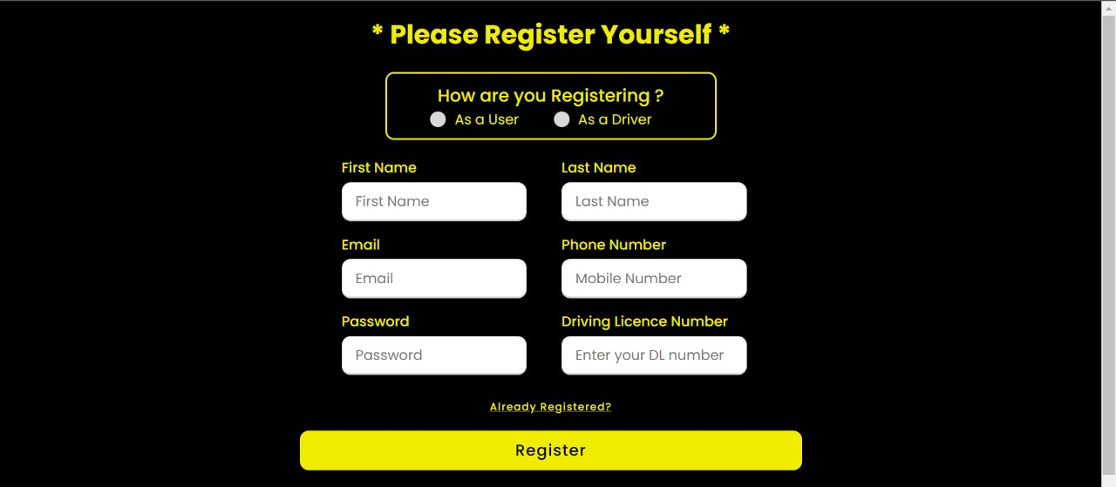
FRONT-END

Slide 7
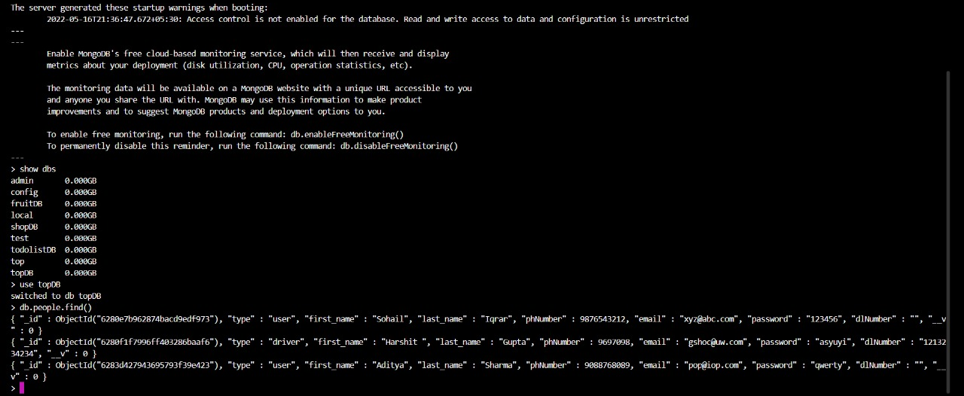
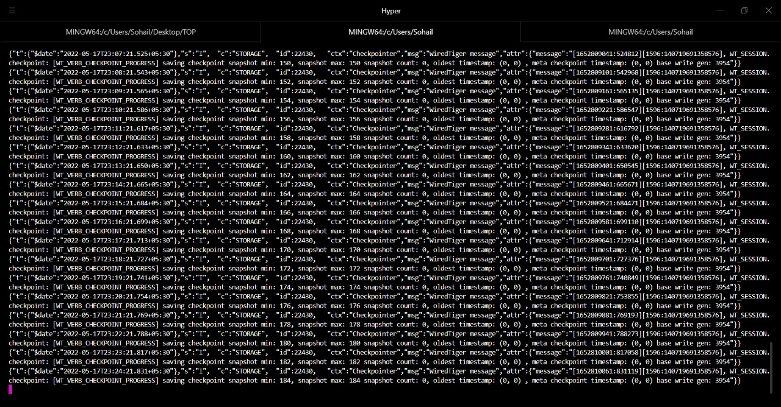
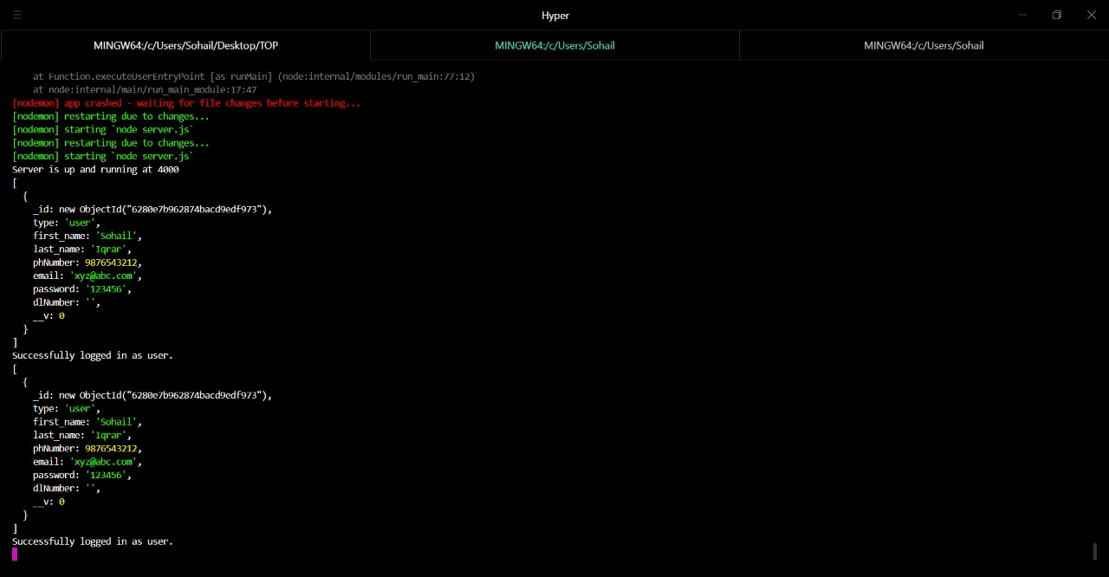
BACK-END

Slide 8
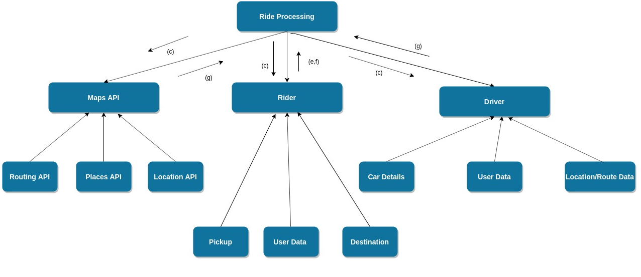
Data Flow Diagram

Slide 9
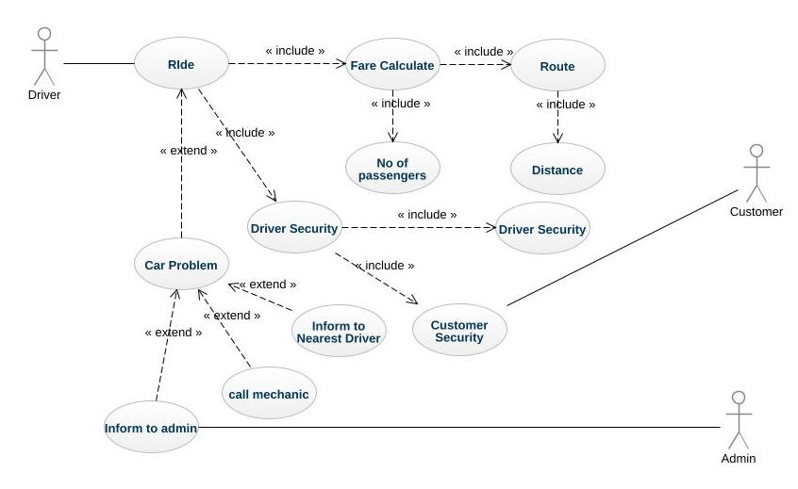
Use Case Diagram

Slide 10
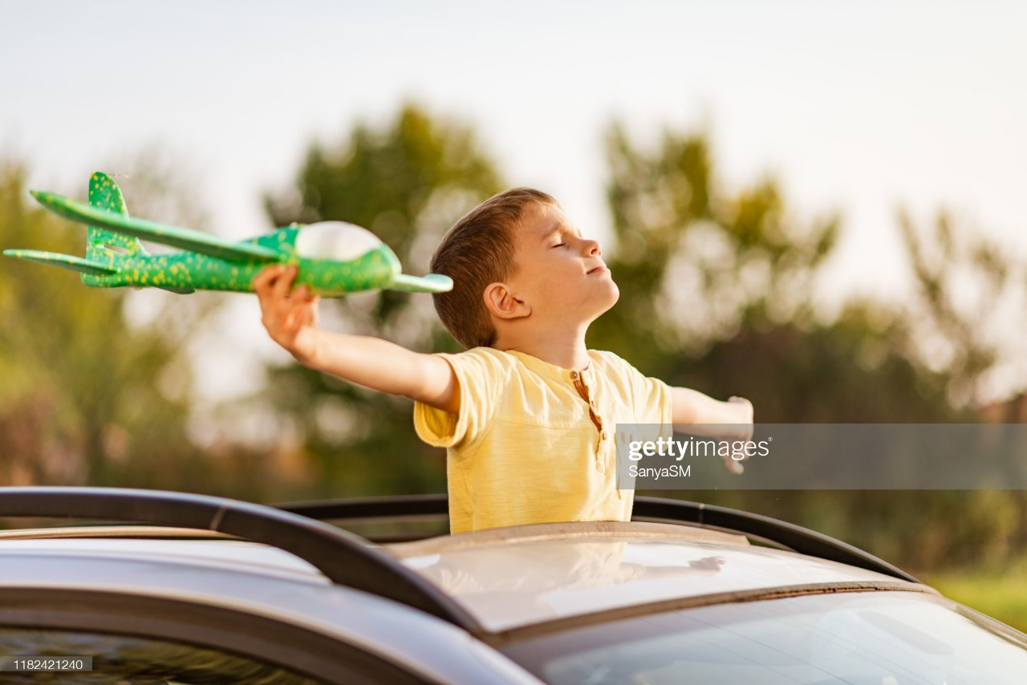
OUTCOMES
The very motive and aim of our efforts through this project is to make people spend less money as they share the amount on every ride with others who also do the same. Our little efforts of carpooling helps people to use lesser number of vehicles as compared to what they would have done if travelled alone causing a drastic effect on pollution and also lessens the traffic overall.

Slide 11

Please do visit our website to get a better experience.

